Slide 1
Welcome!
Mermaids @ The Fringe 2025 Info Meeting
3rd November 2025

Slide 2
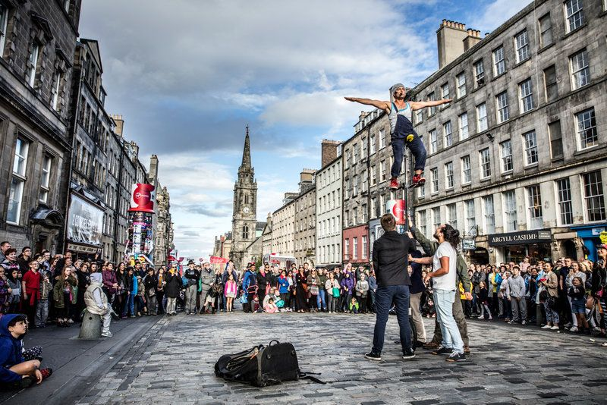
What is the Fringe?
Largest arts festival in the world; Around 55,000 performances, 300 venues and 250 000 spectators
Surpassed only by the Olympics and the World cup in terms of global ticketed events
An excellent opportunity to showcase your talents on an international stage and to see some new and exciting shows by up and coming artists
Founded 1947; 78th festival in 2025 => 1st - 25th August
In 2022, Mermaids took 3 plays to Edinburgh, all student originals, and supported many other St Andrews shows.
We are happy to hear proposals for shows of any genre
(drama, comedy, farce, historical, storytelling etc.)
“The Edinburgh Festival Fringe is the single greatest celebration of arts and culture on the planet. For three weeks in August, the city of Edinburgh welcomes an explosion of creative energy from around the globe” - www.edfringe.com

Slide 3
Performing at the Fringe
Rehearsals start at the end of July/ beginning of August (depending on show slot)
each team gets about 2 weeks of daily 7 hour rehearsal slots in St Andrews
90 minute Tech Run in Edinburgh venue on the day before your opening night
1 week of daily shows at the Fringe (break on Sundays)
50 minute run
Flyering - on the Royal Mile
Publicity is very important during the Fringe as so many shows are competing for attention! Setting up a flyering schedule for your team, covering different hours of the day is a strong suggestion!
See other shows - Performance passes get you standby access and other discounts

Slide 4
Things to keep in mind
Summer availability
The 2025 Fringe runs from August 1st-25th, and you will need to be available for your show slot in Edinburgh during this time as well as your rehearsal slots in St Andrews beforehand
(*if passed these dates will be given to you well in advance)
Make sure when casting that all cast members will be available for these summer dates
Mermaids cannot subsidize any travel or accommodation costs, either in Edinburgh during the
show run or in St Andrews during rehearsals - teams must privately organise this
The Fringe rep (MermaidsFringe@) will be available to assist in finding travel and accommodation but cannot use Mermaids funds, so be sure to keep this in mind when applying.
Here are some places to look for accommodation: Airbnb, Unite Students, www.edfringe.com, etc.
Fringe shows are smaller scale than a typical Mermaids show
Because of venue capacity, time constraints and venue size, shows that are more complicated may prove more difficult to put on => there is often limited storage space, which is worth considering when it comes to set and props which may have to be transported every show day
Think about shows with little to no rights fees - public domain/student written shows are highly suggested!

Slide 5
Sounds Exciting? Here’s what to do next
Attend this info session (congrats, you have done this!)
Gather your team and complete proposal forms
You must have a Director, Producer and Publicity Manager at this stage to be passed in proposals. A technician would also be ideal, but is not required.
Your team can have as many roles as you like beyond this, but at a minimum you must have these roles filled
Attend Office Hours with the Fringe Representative
Wednesdays 9-12 @ Rectors, (*you must attend one of these sessions before proposing a show - proposals coming up after christmas, come before)
Submit Proposal + relevant materials to (Lsea1@) by Friday, 31st January @ 23.59
Attend proposal Meeting - Sunday, 2nd February @ 1-3 pm
Also Check out the Edinburgh Fringe Website for all the key Fringe deadlines + info

Slide 6
Your Proposal
In your proposal, you will need to submit:
Proposal Form
Risk Assessment
Budget Form
Any other information you can provide is also very helpful!
A publicity plan - think beyond just social media and flyering, the more the better at the Fringe. Please also include any early graphic design ideas.
Set design sketches - How will you use/fill the space?
Tech details is also very helpful; all technical specs about Greenside venues can be found on their website, www.greensidevenue.co.uk
Proposals are due on Friday 31st January @ 23.59
Proposal meeting will occur on 2nd February @ 1-3 pm and will follow the same format as regular Mermaids proposals
Access all the proposal materials on via Mermaids website!

Slide 7
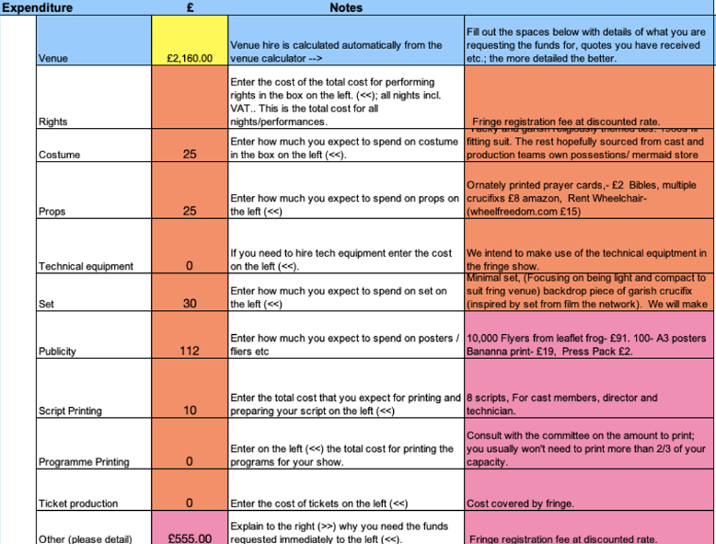
Fringe Budget
Sample Budget Form
Venue hire and Fringe registration fees are expensive. Try to keep additional production costs to a minimum:
Show rights - public domain/student written shows are very budget friendly and highly encouraged
Tech costs - Greenside necessary provides tech equipment. The venues are small so no need for mic hire.
Props & Set - Think about how you can make your show exciting with as little props and set as possible to stay budget friendly and mobile in Edinburgh

Slide 8
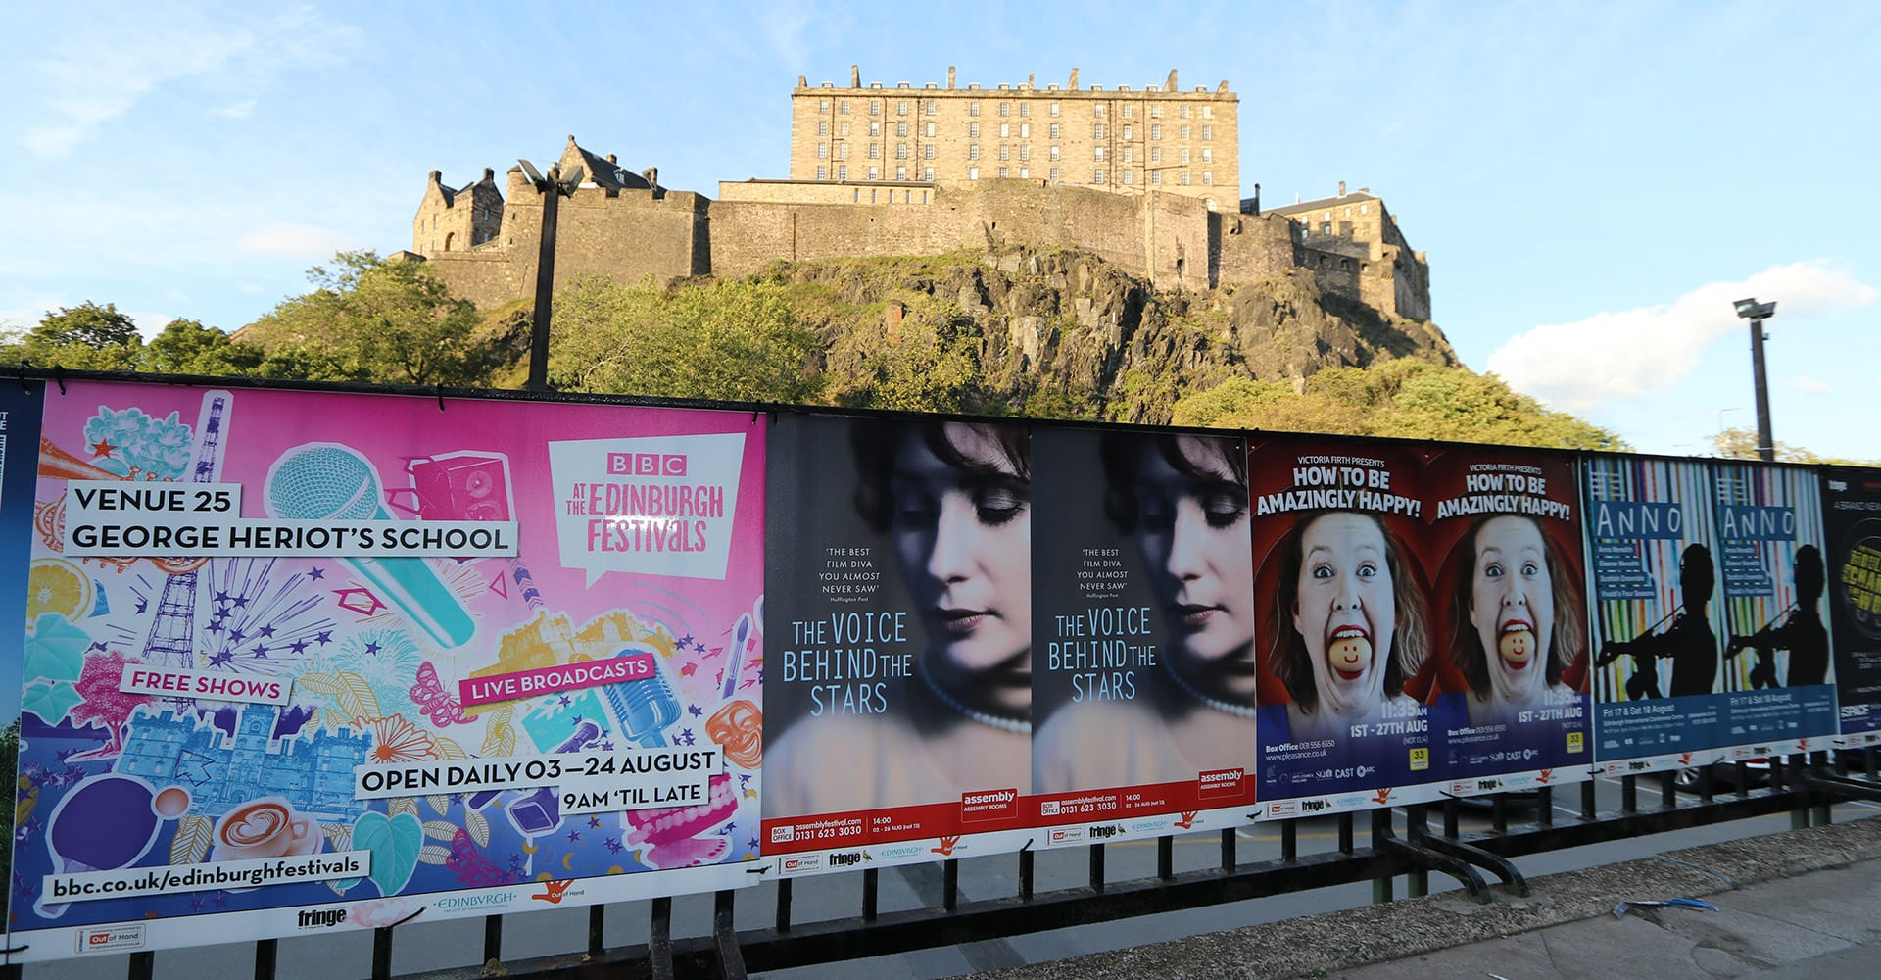
Fringe Budget
Publicity - Publicity is a major part of a successful Fringe and requires a greater budget than a regular Mermaids show in St Andrews. A Fringe publicity budget must cover a minimum of flyers and the required 20 x A3 posters for the venue - additional material are not a must. A rough estimation of a fringe publicity budget is between £80-120.
Some suggested sources for publicity material:
Posters: LeafletFrog A3 Posters
Flyers: LeafletFrog A5 Flyers
Stickers: Banana Print Stickers
Merchandise: Yazzoo Personalised Clothing
Mermaids hope to cover outdoor marketing in Edinburgh!
Budget Info to Remember!
1. Contingency at 15-20% 2. budget attendance at 0.25 3. Fringe registration fee in contingency
4. Mermaids cannot fund travel, accommodation or show merchandise

Slide 9
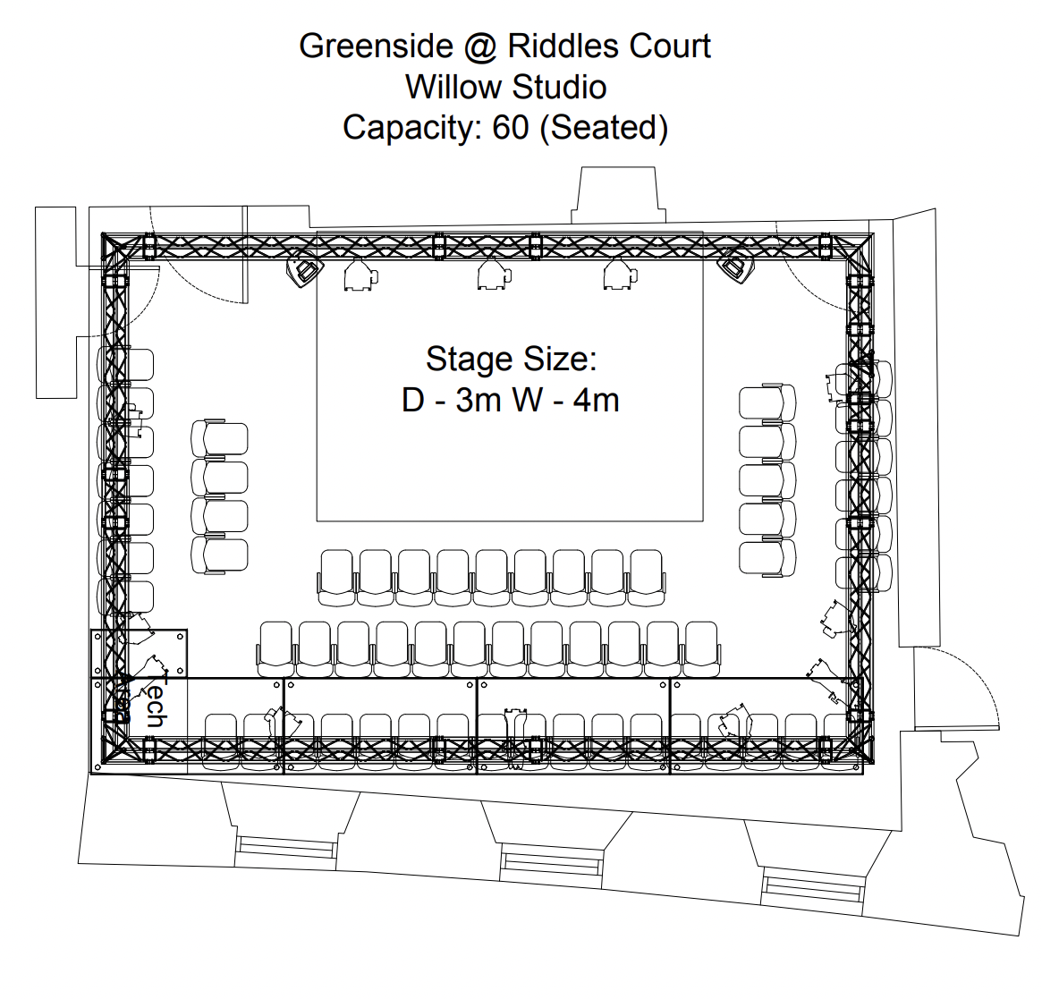
Mermaids Fringe Slots 2025
Mermaids has 3 show slots booked for the Fringe 2025, all at Greenside @ Riddles Street, Willow Studio. Times and dates are approximately as follows:
Week 1, August 1st - 9th @ 12:40-13:50
Week 2, August 11th -16th @ 12:40 - 15:50
Week 3, August 18th - 23rd @ 12:40 - 15:50
Please do not contact Greenside unless asked to do so by Mermaids! Feel free to direct any questions to MermaidsFringe@st-andrews.ac.uk

Slide 10
Performing at Greenside Venues
Each slot is an 1 hour and 10 mins, which includes get in and get out
We recommend a 50 min show with 10 mins for get in and 10 for get out
Backstage storage is very limited
Props storage is available, but larger scale set pieces will have to be transported by the production teams and actors themselves to the venue each show day. Mermaids cannot help with this.
Closer to the performance date, teams will complete a technical form for Greenside, sent out by Mermaids
This will include risk assessments details as well as all set/props/ etc. details
Full info about venues & performance details can be found on the Greenside Venues Website
Look at the Performer Pack (Apply => Performers) for a comprehensive guide to Greenside

Slide 11
Funding Conditions
In order to be passed and granted funding by Mermaids, these are some conditions that must be met by the teams that are passed throughout the Fringe process
Include Mermaids @ Fringe logo, University of St Andrews logo and Greenside logo on all printed publicity material - these will be provided closer to date
Update the show budget regularly
Attend Mermaids Monday meetings after proposals
Follow all venue rules and deadlines, and regularly update the Fringe rep on any details or issues that the venue should know about
Have at least one point of contact in the team that stays in frequent contact with the Fringe rep, both during the semester and summer, and that the Fringe rep can easily contact if needed.
Make sure to be on top of publicity and press; create your social media accounts early and write your press releases as soon as possible.
Any set you do decide to bring to the Fringe (we recommend none) is fully your responsibility to transport back and forth to Edinburgh. Mermaids cannot help with this.

Slide 12
Next Steps & Important Dates
Gather a team and decide on a show!
Remember, if you decide to propose a student written show, the script does not have to be done by the proposal due date! Mermaids requires it to be sent in by the end of May 2025 if the show is passed.
Visit office hours before submitting your proposal!
This is required for your show to be passed
Wednesday 9-12 @ Rectors, or email or an appointment
Submit proposals by Friday 31st January @ 23.59 to (MermaidsFringe@st-andrews.ac.uk)
Get excited for the Fringe: 1st-25th of August 2025!!

Slide 13
Questions?
Any questions / concerns / comments?
Email Romo at: MermaidsFringe@st-andrews.ac.uk
My office hours:
Wednesdays @ 9-12 in Rectors
Thank you!!
@mermaidsstafringe

